Slide 1
Information Extraction Craig Knoblock University of Southern California
Thanks to Andrew McCallum, William Cohen, Matt Michelson, and others who graciously made their slides available.

Slide 2
Outline
What is information extraction
Information extraction landscape
Inner workings of one technique

Slide 3
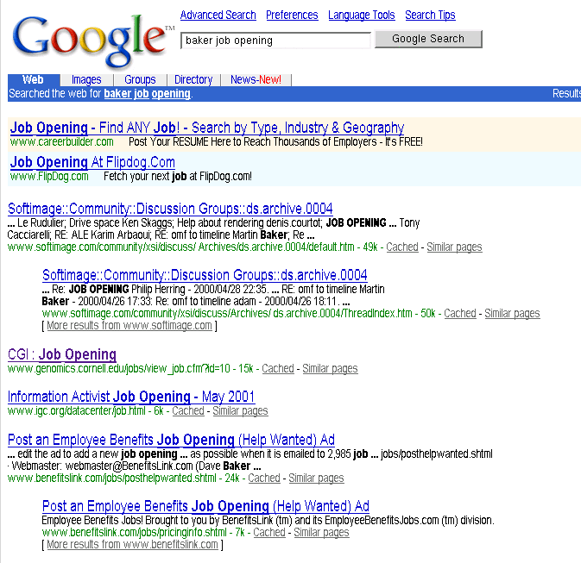
Example: The Problem
Martin Baker, a person
Genomics job
Employers job posting form

Slide 4
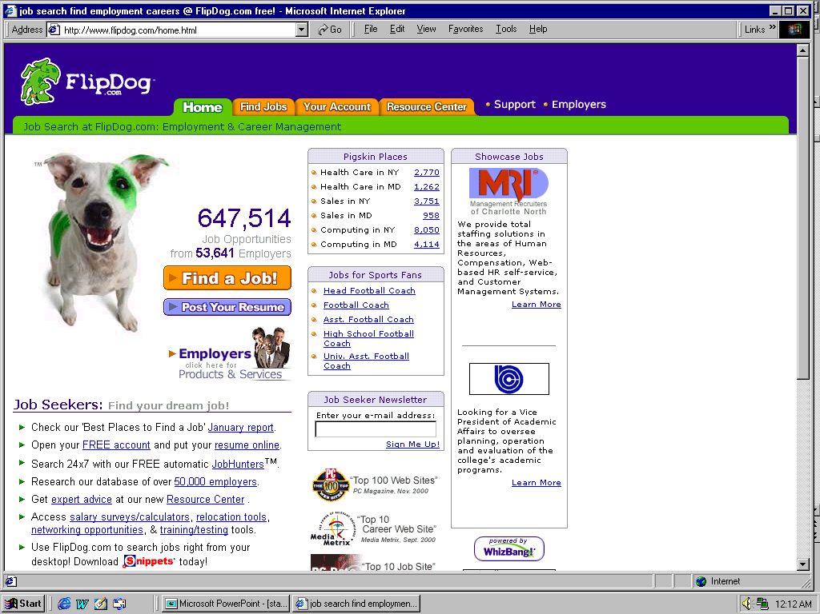
Example: A Solution

Slide 5

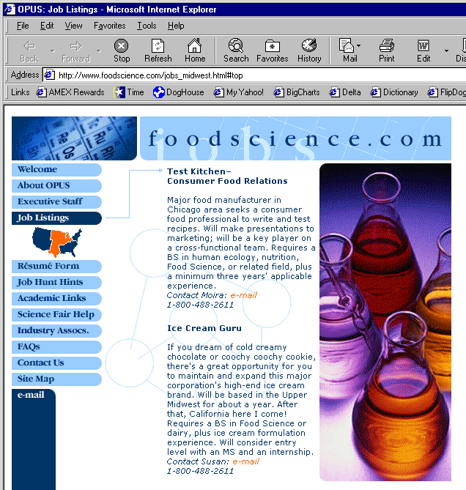
Extracting Job Openings from the Web
foodscience.com-Job2
JobTitle: Ice Cream Guru
Employer: foodscience.com
JobCategory: Travel/Hospitality
JobFunction: Food Services
JobLocation: Upper Midwest
Contact Phone: 800-488-2611
DateExtracted: January 8, 2001
Source: www.foodscience.com/jobs_midwest.html
OtherCompanyJobs: foodscience.com-Job1
Notes:
WB’s first application area is extracting job openings from the web.
Start at company home page, automatically follow links to find the job openings section, segment job openings from each other, and extract job title, location, description, and all of these fields.
(Notice that capitalization, position on page, bold face are just as much indicators of this being a job title as the words themselves.
Notice also that part of the IE task is figuring out which links to follow. And often data for a relation came from multiple different pages.)

Slide 6
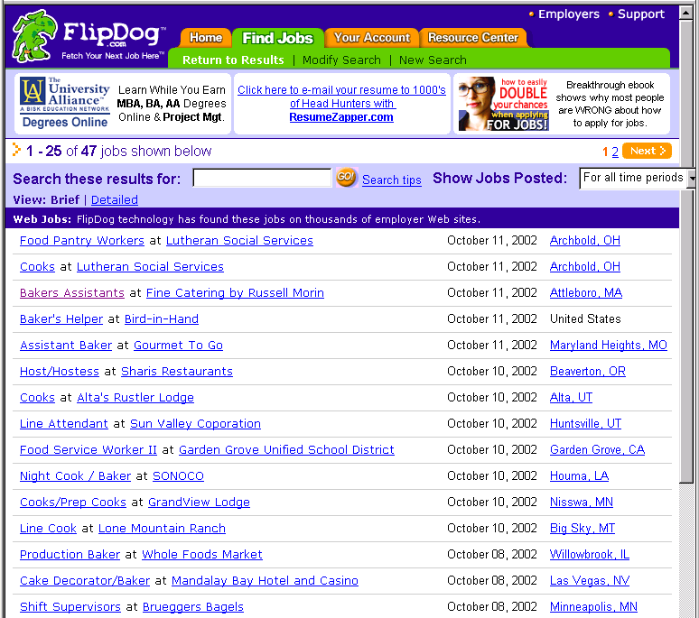
Job Openings:
Category = Food Services
Keyword = Baker
Location = Continental U.S.
Notes:
Not only did this support extremely useful and targeted search and data navigation, with highly summarized display

Slide 7
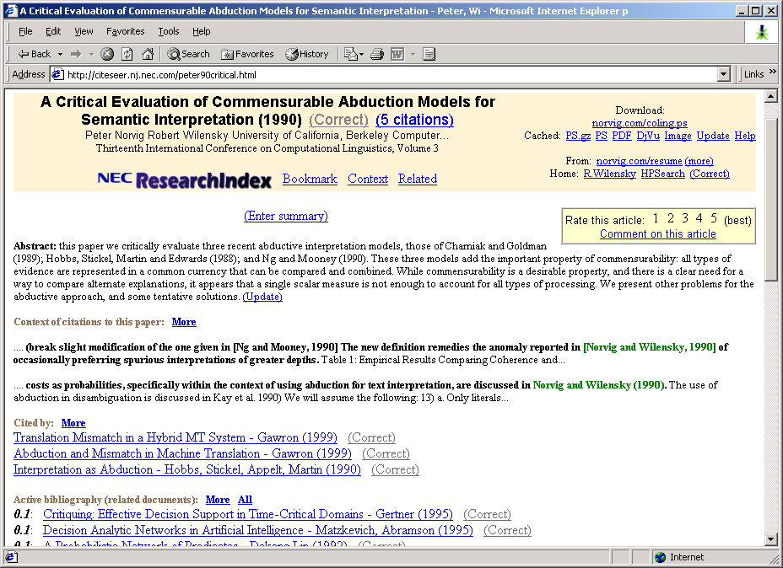
IE from Research Papers
Notes:
CiteSeer, which we all know and love, is made possible by the automatic extraction of title and author information from research paper headers and references in order to build the reference graph that we use to find related work.

Slide 8
What is “Information Extraction”
As a task:
Filling slots in a database from sub-segments of text.
October 14, 2002, 4:00 a.m. PT
For years, Microsoft Corporation CEO Bill Gates railed against the economic philosophy of open-source software with Orwellian fervor, denouncing its communal licensing as a "cancer" that stifled technological innovation.
Today, Microsoft claims to "love" the open-source concept, by which software code is made public to encourage improvement and development by outside programmers. Gates himself says Microsoft will gladly disclose its crown jewels--the coveted code behind the Windows operating system--to select customers.
"We can be open source. We love the concept of shared source," said Bill Veghte, a Microsoft VP. "That's a super-important shift for us in terms of code access.“
Richard Stallman, founder of the Free Software Foundation, countered saying…
NAME TITLE ORGANIZATION
Notes:
What is IE. As a task it is…
Starting with some text… and a empty data base with a defined ontology of fields and records,
Use the information in the text to fill the database.

Slide 9
What is “Information Extraction”
As a task:
Filling slots in a database from sub-segments of text.
October 14, 2002, 4:00 a.m. PT
For years, Microsoft Corporation CEO Bill Gates railed against the economic philosophy of open-source software with Orwellian fervor, denouncing its communal licensing as a "cancer" that stifled technological innovation.
Today, Microsoft claims to "love" the open-source concept, by which software code is made public to encourage improvement and development by outside programmers. Gates himself says Microsoft will gladly disclose its crown jewels--the coveted code behind the Windows operating system--to select customers.
"We can be open source. We love the concept of shared source," said Bill Veghte, a Microsoft VP. "That's a super-important shift for us in terms of code access.“
Richard Stallman, founder of the Free Software Foundation, countered saying…
IE
NAME TITLE ORGANIZATION
Bill Gates CEO Microsoft
Bill Veghte VP Microsoft
Richard Stallman founder Free Soft..

Slide 10
What is “Information Extraction”
As a family of techniques:
Information Extraction =
segmentation + classification + clustering + association
October 14, 2002, 4:00 a.m. PT
For years, Microsoft Corporation CEO Bill Gates railed against the economic philosophy of open-source software with Orwellian fervor, denouncing its communal licensing as a "cancer" that stifled technological innovation.
Today, Microsoft claims to "love" the open-source concept, by which software code is made public to encourage improvement and development by outside programmers. Gates himself says Microsoft will gladly disclose its crown jewels--the coveted code behind the Windows operating system--to select customers.
"We can be open source. We love the concept of shared source," said Bill Veghte, a Microsoft VP. "That's a super-important shift for us in terms of code access.“
Richard Stallman, founder of the Free Software Foundation, countered saying…
Microsoft Corporation
CEO
Bill Gates
Microsoft
Gates
Microsoft
Bill Veghte
Microsoft
VP
Richard Stallman
founder
Free Software Foundation
aka “named entity extraction”
Notes:
As a family of techniques, is consists of
Segmentation to find the beginning and ending boundaries of the text snippets that will go in the DB.
Classification…

Slide 11
What is “Information Extraction”
As a family of techniques:
Information Extraction =
segmentation + classification + association + clustering
October 14, 2002, 4:00 a.m. PT
For years, Microsoft Corporation CEO Bill Gates railed against the economic philosophy of open-source software with Orwellian fervor, denouncing its communal licensing as a "cancer" that stifled technological innovation.
Today, Microsoft claims to "love" the open-source concept, by which software code is made public to encourage improvement and development by outside programmers. Gates himself says Microsoft will gladly disclose its crown jewels--the coveted code behind the Windows operating system--to select customers.
"We can be open source. We love the concept of shared source," said Bill Veghte, a Microsoft VP. "That's a super-important shift for us in terms of code access.“
Richard Stallman, founder of the Free Software Foundation, countered saying…
Microsoft Corporation
CEO
Bill Gates
Microsoft
Gates
Microsoft
Bill Veghte
Microsoft
VP
Richard Stallman
founder
Free Software Foundation

Slide 12
What is “Information Extraction”
As a family of techniques:
Information Extraction =
segmentation + classification + association + clustering
October 14, 2002, 4:00 a.m. PT
For years, Microsoft Corporation CEO Bill Gates railed against the economic philosophy of open-source software with Orwellian fervor, denouncing its communal licensing as a "cancer" that stifled technological innovation.
Today, Microsoft claims to "love" the open-source concept, by which software code is made public to encourage improvement and development by outside programmers. Gates himself says Microsoft will gladly disclose its crown jewels--the coveted code behind the Windows operating system--to select customers.
"We can be open source. We love the concept of shared source," said Bill Veghte, a Microsoft VP. "That's a super-important shift for us in terms of code access.“
Richard Stallman, founder of the Free Software Foundation, countered saying…
Microsoft Corporation
CEO
Bill Gates
Microsoft
Gates
Microsoft
Bill Veghte
Microsoft
VP
Richard Stallman
founder
Free Software Foundation

Slide 13
What is “Information Extraction”
As a family of techniques:
Information Extraction =
segmentation + classification + association + clustering
October 14, 2002, 4:00 a.m. PT
For years, Microsoft Corporation CEO Bill Gates railed against the economic philosophy of open-source software with Orwellian fervor, denouncing its communal licensing as a "cancer" that stifled technological innovation.
Today, Microsoft claims to "love" the open-source concept, by which software code is made public to encourage improvement and development by outside programmers. Gates himself says Microsoft will gladly disclose its crown jewels--the coveted code behind the Windows operating system--to select customers.
"We can be open source. We love the concept of shared source," said Bill Veghte, a Microsoft VP. "That's a super-important shift for us in terms of code access.“
Richard Stallman, founder of the Free Software Foundation, countered saying…
*
Microsoft Corporation
CEO
Bill Gates
Microsoft
Gates
Microsoft
Bill Veghte
Microsoft
VP
Richard Stallman
founder
Free Software Foundation
*
*
NAME
TITLE ORGANIZATION
Bill Gates
CEO
Microsoft
*
Bill
Veghte
VP
Microsoft
Richard
Stallman
founder
Free Soft..

Slide 14
IE in Context
Create ontology
Spider
Filter by relevance
IE
Segment
Classify
Associate
Cluster
Database
Load DB
Document collection
Train extraction models
Query,
Search
Label training data
Data mine

Slide 15
Why IE from the Web?
Science
Grand old dream of AI: Build large KB* and reason with it. IE from the Web enables the creation of this KB.
IE from the Web is a complex problem that inspires new advances in machine learning.
Profit
Many companies interested in leveraging data currently “locked in unstructured text on the Web”.
Not yet a monopolistic winner in this space.
Fun!
Build tools that we researchers like to use ourselves: Cora & CiteSeer, MRQE.com, FAQFinder,…
See our work get used by the general public.
* KB = “Knowledge Base”
Notes:
Poor Doug Lenat, creating Cyc. I was there at ICML in 1991… Now 11 years later.

Slide 16
IE History
Pre-Web
Mostly news articles
De Jong’s FRUMP [1982]
Hand-built system to fill Schank-style “scripts” from news wire
Message Understanding Conference (MUC) DARPA [’87-’95], TIPSTER [’92-’96]
Most early work dominated by hand-built models
E.g. SRI’s FASTUS, hand-built FSMs.
But by 1990’s, some machine learning: Lehnert, Cardie, Grishman and then HMMs: Elkan [Leek ’97], BBN [Bikel et al ’98]
Web
AAAI ’94 Spring Symposium on “Software Agents”
Much discussion of ML applied to Web. Maes, Mitchell, Etzioni.
Tom Mitchell’s WebKB, ‘96
Build KB’s from the Web.
Wrapper Induction
Initially hand-build, then ML: [Soderland ’96], [Kushmeric ’97],…
Notes:
ML… although this is an area where ML has not yet trounced the hand-built systems. In some of the latest evaluations, hand-built shared 1st place with a ML.
Now many companies making a business from IE (from the Web): WasBang, Inxight, Intelliseek, ClearForest.

Slide 17
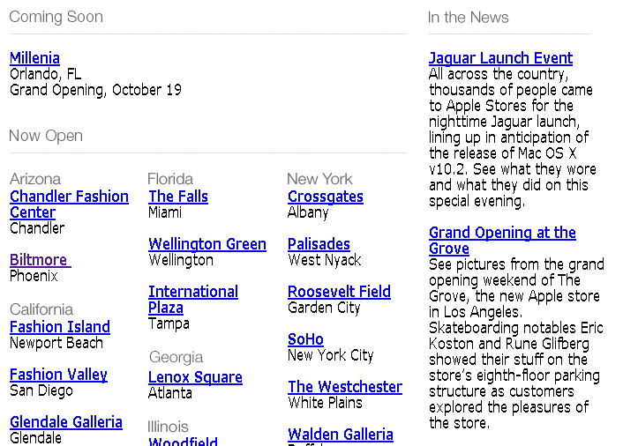
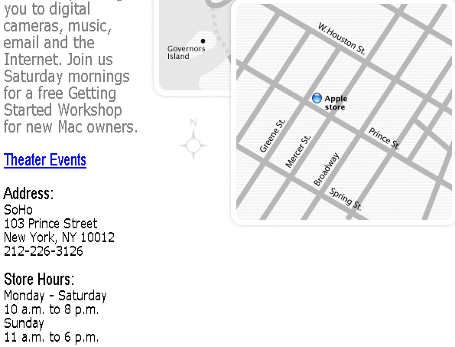
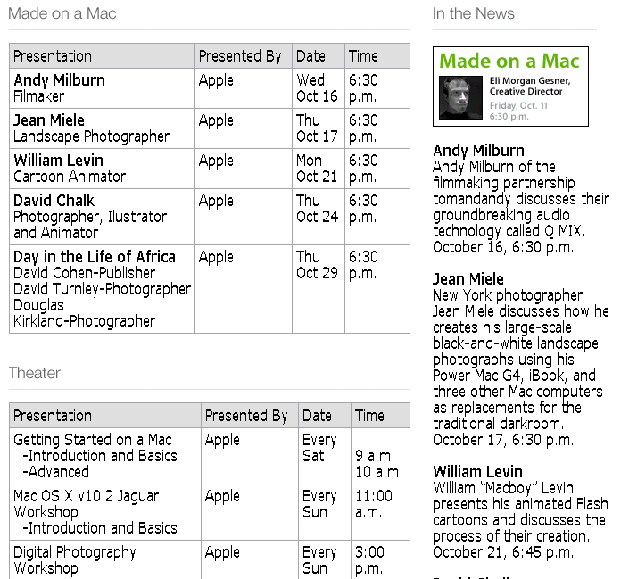
What makes IE from the Web Different?
Less grammar, but more formatting & linking
Newswire
Web
www.apple.com/retail
Apple to Open Its First Retail Store
in New York City
MACWORLD EXPO, NEW YORK--July 17, 2002--Apple's first retail store in New York City will open in Manhattan's SoHo district on Thursday, July 18 at 8:00 a.m. EDT. The SoHo store will be Apple's largest retail store to date and is a stunning example of Apple's commitment to offering customers the world's best computer shopping experience.
"Fourteen months after opening our first retail store, our 31 stores are attracting over 100,000 visitors each week," said Steve Jobs, Apple's CEO. "We hope our SoHo store will surprise and delight both Mac and PC users who want to see everything the Mac can do to enhance their digital lifestyles."
www.apple.com/retail/soho
www.apple.com/retail/soho/theatre.html
The directory structure, link structure, formatting & layout of the Web is its own new grammar.
Notes:
Traditionally, IE was done mostly on newswire: flowing, grammatical sentences with little or no formatting information.
The Web is different: less grammar, more ungrammatical little snippets, but rich formatting and layout information.
This directory structure…
So lets consider the dimensions of the IE landscape.
First some ways in which the problem space varies:

Slide 18
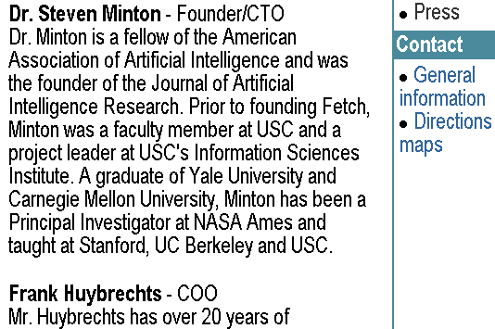
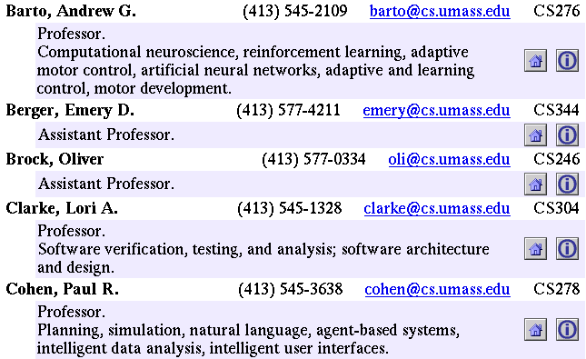
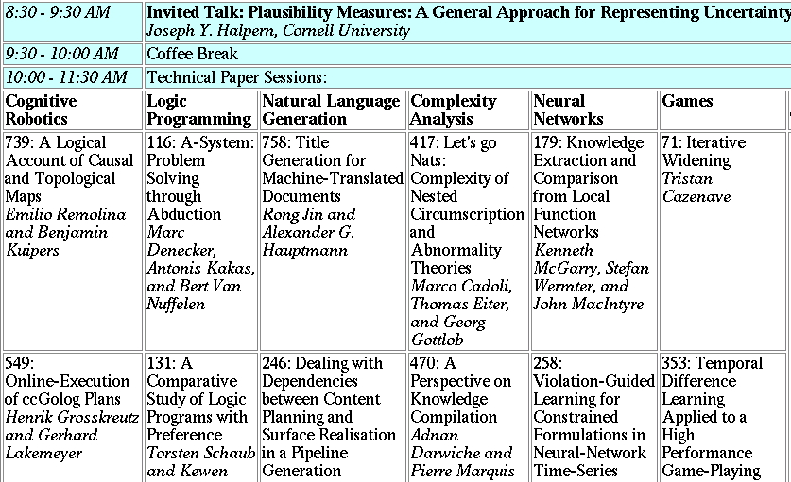
Landscape of IE Tasks (1/4): Pattern Feature Domain
Text paragraphs
without formatting
Grammatical sentences and some formatting & links
Astro Teller is the CEO and co-founder of BodyMedia. Astro holds a Ph.D. in Artificial Intelligence from Carnegie Mellon University, where he was inducted as a national Hertz fellow. His M.S. in symbolic and heuristic computation and B.S. in computer science are from Stanford University. His work in science, literature and business has appeared in international media from the New York Times to CNN to NPR.
Non-grammatical snippets, rich formatting & links
Tables
Notes:
Different families of features may be more or less useful in different data sets.

Slide 19
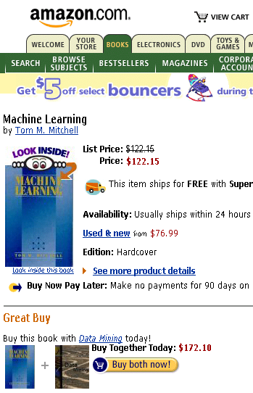


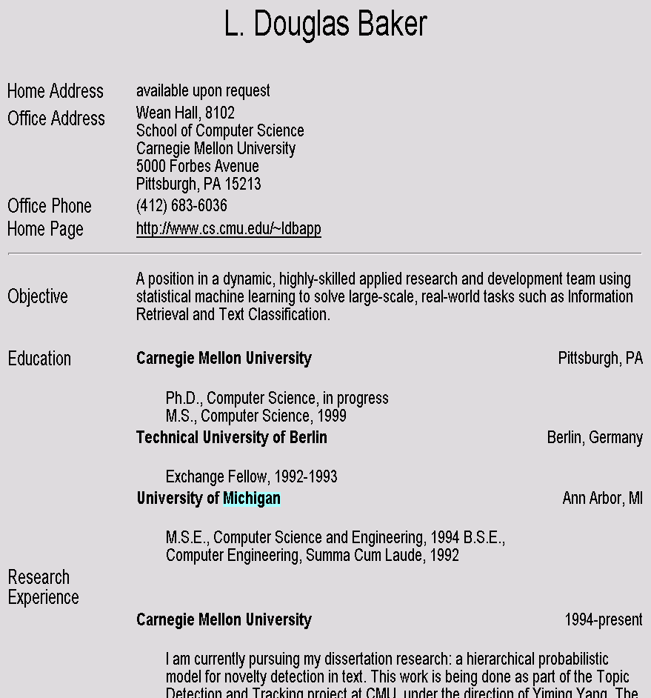
Landscape of IE Tasks (2/4): Pattern Scope
Web site specific
Genre specific
Wide, non-specific
Formatting
Layout
Language
Amazon.com Book Pages
Resumes
University Names
Notes:
If you were going to use formatting to do extraction, how often (with what granularity) would you have to re-train your models?

Slide 20
Landscape of IE Tasks (3/4): Pattern Complexity
E.g. word patterns:
Closed set
Regular set
U.S. states
U.S. phone numbers
He was born in Alabama…
Phone: (413) 545-1323
The big Wyoming sky…
The CALD main office can be reached at 412-268-1299
Complex pattern
Ambiguous patterns, needing context and many sources of evidence
U.S. postal addresses
University of Arkansas
P.O. Box 140
Hope, AR 71802
Person names
…was among the six houses sold by Hope Feldman that year.
Headquarters:
1128 Main Street, 4th Floor
Cincinnati, Ohio 45210
Pawel Opalinski, Software Engineer at WhizBang Labs.
Notes:
How complicated a modeling technique will you have to use?

Slide 21
Landscape of IE Tasks (4/4): Pattern Combinations
Jack Welch will retire as CEO of General Electric tomorrow. The top role at the Connecticut company will be filled by Jeffrey Immelt.
Single entity
Binary relationship
N-ary record
Person: Jack Welch
Relation: Person-Title
Person: Jack Welch
Title: CEO
Relation: Succession
Company: General Electric
Title: CEO
Out: Jack Welsh
In: Jeffrey Immelt
Person: Jeffrey Immelt
Location: Connecticut
Relation: Company-Location
Company: General Electric
Location: Connecticut
“Named entity” extraction
Notes:
How many components of the output of your system? Single entity…
It is more difficult to get high accuracy on the right than on the left, because each consituent has to be right, and errors compound. 90%^5=60%

Slide 22
Evaluation of Single Entity Extraction
TRUTH:
Michael Kearns and Sebastian Seung will start Monday’s tutorial, followed by Richard M. Karpe and Martin Cooke.
PRED:
Michael Kearns and Sebastian Seung will start Monday’s tutorial, followed by Richard M. Karpe and Martin Cooke.
# correctly predicted segments 2
Precision = =
# predicted segments 6
# correctly predicted segments 2
Recall = =
# true segments 4
1
F1 = Harmonic mean of Precision & Recall =
((1/P) + (1/R)) / 2

Slide 23
State of the Art Performance
Named entity recognition
Person, Location, Organization, …
F1 in high 80’s or low- to mid-90’s
Binary relation extraction
Contained-in (Location1, Location2) Member-of (Person1, Organization1)
F1 in 60’s or 70’s or 80’s
Wrapper induction
Extremely accurate performance obtainable
Human effort (~30min) required on each site

Slide 24
Landscape of IE Techniques (1/1): Models
Classify Pre-segmented Candidates
Lexicons
Sliding Window
Abraham Lincoln was born in Kentucky.
Abraham Lincoln was born in Kentucky.
Abraham Lincoln was born in Kentucky.
member?
Classifier
Alabama
Alaska
…
Wisconsin
Wyoming
Classifier
which class?
which class?
Try alternate window sizes:
Boundary Models
Finite State Machines
Context Free Grammars
Abraham Lincoln was born in Kentucky.
Abraham Lincoln was born in Kentucky.
Abraham Lincoln was born in Kentucky.
BEGIN
Most likely state sequence?
NNP
NNP
V
V
P
NP
Classifier
Most likely parse?
PP
which class?
VP
NP
VP
BEGIN
END
BEGIN
END
S
…and beyond
Any of these models can be used to capture words, formatting or both.

Slide 25
Lexicons/Reference Sets

Slide 26
Outline
Introduction
Alignment
Extraction
Results
Discussion

Slide 27
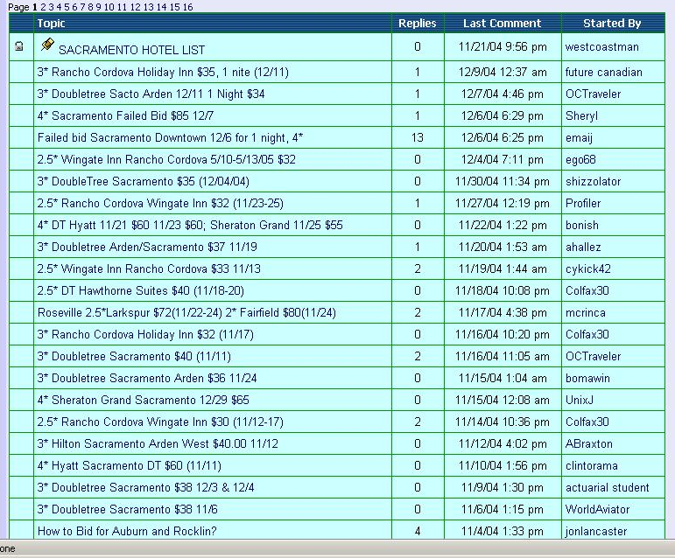
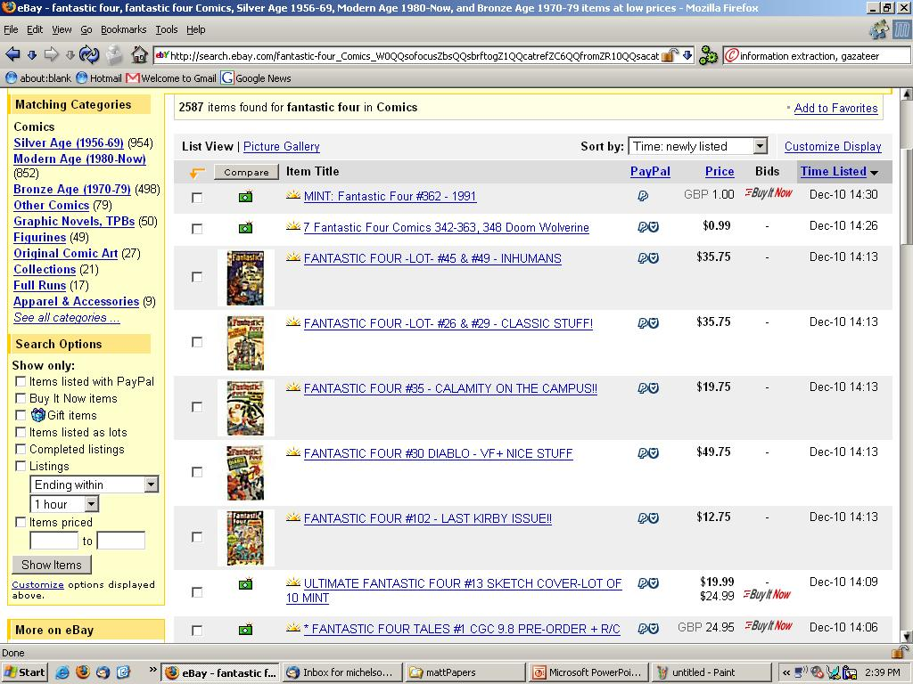
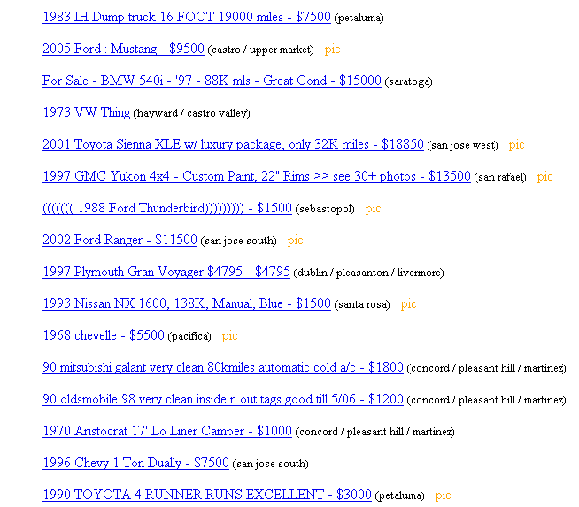
Ungrammatical & Unstructured Text

Slide 28
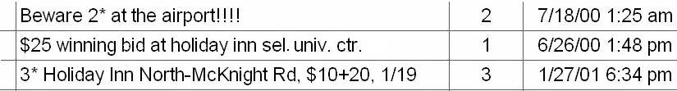
Ungrammatical & Unstructured Text
For simplicity → “posts”
Goal:
<hotelArea>univ. ctr.</hotelArea>
<price>$25</price>
<hotelName>holiday inn sel.</hotelName>
Wrapper based IE does not apply (e.g. Stalker, RoadRunner)
NLP based IE does not apply (e.g. Rapier)

Slide 29
Reference Sets
IE infused with outside knowledge
“Reference Sets”
Collections of known entities and the associated attributes
Online (offline) set of docs
CIA World Fact Book
Online (offline) database
Comics Price Guide, Edmunds, etc.
Build from ontologies on Semantic Web

Slide 30
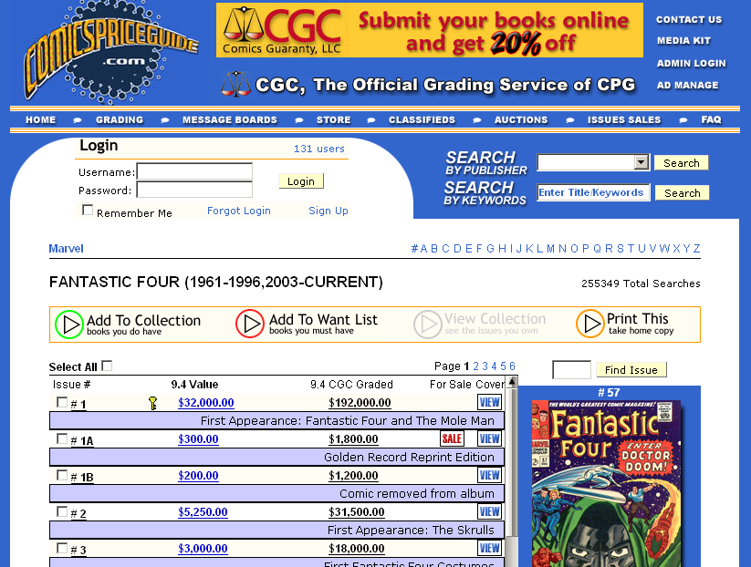
Comics Price Guide Reference Set

Slide 31
Algorithm Overview – Use of Ref Sets

Slide 32
Outline
Introduction
Alignment
Extraction
Results
Discussion

Slide 33

Our Record Linkage Problem
Posts not yet decomposed attributes.
Extra tokens that match nothing in Ref Set.
Post:
“$25 winning bid at holiday inn sel. univ. ctr.”
hotel name
hotel area
Reference Set:
Holiday Inn | Greentree
Holiday Inn Select | University Center
Hyatt Regency | Downtown
hotel name
hotel area

Slide 34
Our Record Linkage Solution
P = “$25 winning bid at holiday inn sel. univ. ctr.”
Record Level Similarity + Field Level Similarities
V_{RL} = < RL_scores(P, “Hyatt Regency Downtown”),
RL_scores(P, “Hyatt Regency”),
RL_scores(P, “Downtown”)>
Binary Rescoring
SVM
Best matching member of the reference set for the post

Slide 35
Last Alignment Step
Return reference set attributes as annotation for the post
Post:
$25 winning bid at holiday inn sel. univ. ctr.
<Ref_hotelName>Holiday Inn Select</Ref_hotelName>
<Ref_hotelArea>University Center</Ref_hotelArea>

Slide 36
Outline
Introduction
Alignment
Extraction
Results
Discussion

Slide 37
Extraction Algorithm
Post:
$25 winning bid at holiday inn sel. univ. ctr.
V_{IE} = <common_scores(token),
IE_scores(token, attr1),
IE_scores(token, attr2),
… >
Generate V_{IE}
Multiclass SVM
$25 winning bid at holiday inn sel. univ. ctr.
price
hotel name
hotel area
$25 holiday inn sel. univ. ctr.
Clean Whole Attribute

Slide 38
Common Scores
Some attributes not in reference set
Reliable characteristics
Infeasible to represent in reference set
E.g. prices, dates
Can use characteristics to extract/annotate these attributes
Regular expressions, for example
These types of scores are what compose common_scores

Slide 39
Outline
Introduction
Alignment
Extraction
Results
Discussion

Slide 40
Experimental Data Sets
Hotels
Posts
1125 posts from www.biddingfortravel.com
Pittsburgh, Sacramento, San Diego
Star rating, hotel area, hotel name, price, date booked
Reference Set
132 records
Special posts on BFT site.
Per area – list any hotels ever bid on in that area
Star rating, hotel area, hotel name

Slide 41
Experimental Data Sets
Comics
Posts
776 posts from EBay
“Incredible Hulk” and “Fantastic Four” in comics
Title, issue number, price, condition, publisher, publication year, description (1st appearance the Rhino)
Reference Sets
918 comics, 49 condition ratings
Both come from ComicsPriceGuide.com
For FF and IH
Title, issue number, description, publisher

Slide 42
Comparison to Existing Systems
Record Linkage
WHIRL
RL allows non-decomposed attributes
Information Extraction
Simple Tagger (CRF)
State-of-the-art IE
Amilcare
NLP based IE

Slide 43
Record linkage results
 | Prec. | Recall | F-Measure
Hotel
Phoebus | 93.60 | 91.79 | 92.68
WHIRL | 83.52 | 83.61 | 83.13
Comic
Phoebus | 93.24 | 84.48 | 88.64
WHIRL | 73.89 | 81.63 | 77.57
10 trials – 30% train, 70% test

Slide 44
Token level Extraction results: Hotel domain
 |  | Prec. | Recall | F-Measure | Freq
Area | Phoebus | 89.25 | 87.50 | 88.28 | 809.7
 | Simple Tagger | 92.28 | 81.24 | 86.39
 | Amilcare | 74.2 | 78.16 | 76.04
Date | Phoebus | 87.45 | 90.62 | 88.99 | 751.9
 | Simple Tagger | 70.23 | 81.58 | 75.47
 | Amilcare | 93.27 | 81.74 | 86.94
Name | Phoebus | 94.23 | 91.85 | 93.02 | 1873.9
 | Simple Tagger | 93.28 | 93.82 | 93.54
 | Amilcare | 83.61 | 90.49 | 86.90
Price | Phoebus | 98.68 | 92.58 | 95.53 | 850.1
 | Simple Tagger | 75.93 | 85.93 | 80.61
 | Amilcare | 89.66 | 82.68 | 85.86
Star | Phoebus | 97.94 | 96.61 | 97.84 | 766.4
 | Simple Tagger | 97.16 | 97.52 | 97.34
 | Amilcare | 96.50 | 92.26 | 94.27
Not Significant

Slide 45
Token level Extraction results: Comic domain
 |  | Prec. | Recall | F-Measure | Freq
Condition | Phoebus | 91.8 | 84.56 | 88.01 | 410.3
 | Simple Tagger | 78.11 | 77.76 | 77.80
 | Amilcare | 79.18 | 67.74 | 72.80
Descript. | Phoebus | 69.21 | 51.50 | 59.00 | 504.0
 | Simple Tagger | 62.25 | 79.85 | 69.86
 | Amilcare | 55.14 | 58.46 | 56.39
Issue | Phoebus | 93.73 | 86.18 | 89.79 | 669.9
 | Simple Tagger | 86.97 | 85.99 | 86.43
 | Amilcare | 88.58 | 77.68 | 82.67
Price | Phoebus | 80.00 | 60.27 | 68.46 | 10.7
 | Simple Tagger | 84.44 | 44.24 | 55.77
 | Amilcare | 60.00 | 34.75 | 43.54

Slide 46
Token level Extraction results: Comic domain (cont.)
 |  | Prec. | Recall | F-Measure | Freq
Publisher | Phoebus | 83.81 | 95.08 | 89.07 | 61.1
 | Simple Tagger | 88.54 | 78.31 | 82.83
 | Amilcare | 90.82 | 70.48 | 79.73
Title | Phoebus | 97.06 | 89.90 | 93.34 | 1191.1
 | Simple Tagger | 97.54 | 96.63 | 97.07
 | Amilcare | 96.32 | 93.77 | 94.98
Year | Phoebus | 98.81 | 77.60 | 84.92 | 120.9
 | Simple Tagger | 87.07 | 51.05 | 64.24
 | Amilcare | 86.82 | 72.47 | 78.79

Slide 47
Extraction results: Summary
 | Token Level |  |  | Hotel | Field Level
 | Prec. | Recall | F-Mes. |  | Prec. | Recall | F-Mes.
Phoebus | 93.60 | 91.79 | 92.68 |  | 87.44 | 85.59 | 86.51
Simple Tagger | 86.49 | 89.13 | 87.79 |  | 79.19 | 77.23 | 78.20
Amilcare | 86.12 | 86.14 | 86.11 |  | 85.04 | 78.94 | 81.88
 | Token Level |  |  | Comic | Field Level
 | Prec. | Recall | F-Mes. |  | Prec. | Recall | F-Mes.
Phoebus | 93.24 | 84.48 | 88.64 |  | 81.73 | 80.84 | 81.28
Simple Tagger | 84.41 | 86.04 | 85.43 |  | 78.05 | 74.02 | 75.98
Amilcare | 87.66 | 81.22 | 84.29 |  | 90.40 | 72.56 | 80.50

Slide 48
Results Discussion
3 attributes where Phoebus not max F-measure
Hotel name – tiny difference
Comic Title – low recall → lower F-measure
recall: missed tokens of titles not in ref. set
“The Incredible Hulk and Wolverine” → “The Incredible Hulk”
Comic description
Simple Tagger learned internal structure of descriptions
High recall, low precision
Phoebus labels in isolation
Only meaningful tokens (like prop. Names) labeled
higher precision, lower recall → 2nd best F-measure

Slide 49
Outline
Introduction
Alignment
Extraction
Results
Discussion

Slide 50
Summary extraction results
Expensive to label training data…
 | Prec. | Recall | F-Mes. | # Train.
Hotel (30%) | 93.6 | 91.79 | 92.68 | 338
Hotel (10%) | 93.66 | 90.93 | 92.27 | 113
Comic (30%) | 93.24 | 84.48 | 88.64 | 233
Comic (10%) | 91.41 | 83.63 | 87.34 | 78
Token Level
Hotel (30%) | 87.44 | 85.59 | 86.51
Hotel (10%) | 86.52 | 84.54 | 85.52
Comic (30%) | 81.73 | 80.84 | 81.28
Comic (10%) | 79.94 | 76.71 | 78.29
Field Level

Slide 51
Reference Set Attributes as Annotation
Standard query values
Include info not in post
If post leaves out “Star Rating” can still be returned in query on “Star Rating” using ref. set annotation
Perform better at annotation than extraction
Consider Rec. link results as field level extraction
E.g. no system did well extracting comic desc.
+20% precision, +10% recall using rec. link

Slide 52
Reference Set Attributes as Annotation
Then why do extraction at all?
Want to see actual values
Extraction can annotate when record linkage is wrong
Better in some cases at annotation than rec. link
If wrong rec. link, usually close enough record to get some extraction parts right
Learn what something is not
Helps to classify things not in reference set
Learn which tokens to ignore better

